Slide 1

Alexa, What Are Azure Functions?
July 2019 / Nick Cipollina

Slide 2
What is an Alexa Skill?
Alexa Skill Overview

Slide 3

What is an Alexa Skill?
Alexa Skill is like an application a mobile device
Various types:
Custom
Flash Briefing
Smart Home
Music
List
Display Capabilities

Slide 4
How It All Works
Alexa Skill Interaction
Step 1 User Says Command —
Step 2 Alexa Receives Command —
Step 3 Necessary Logic Complete —
Step 4 Response Sent to User —
Interaction flow
The user makes a command to the Alexa device
The Alexa device receives the command and readies it for logic completion
The necessary logic is completed on the command and the response is created
Response is sent back to the Alexa device and spoken and/or displayed to the user

Slide 5





Anatomy of an Alexa Skill
INVOCATION NAME
INTENTS
Invocation Name: Is the name you will give your skill so that the Alexa device knows to launch it. Does not have to be unique.
An action that fulfills a user's spoken request. Intents can have optional arguments called slots
UTTERANCES
SLOTS
A set of likely spoken phrases mapped to intents. This will ideally include as many representative phrases as possible
Slots can be thought of as variables in utterances. They can have predefined values, but by default are empty

Slide 6
Why .Net Core?
How we got here

Slide 7
Observation 1 — .Net Core 2.0 significantly outperforms
“Both C# and F# on .Net Core 2.0 exceeds all expectations and outperforms all other runtimes in average duration. AWS Lambda developers on .Net Core should consider .Net Core 2.0 as the default — and upgrade all existing projects still using 1.0.”
https://read.acloud.guru/comparing-aws-lambda-performance-of-node-js-python-java-c-and-go-29c1163c2581

Slide 8

Thought Process
Found skills kit
Extended Framework
Web API Support
Other supported frameworks were similar
Developed Framework
Researched Existing Tools
Didn’t meet all needs
Developed similar framework
CosmosDB
And…

Slide 9
Azure Function Support!

Slide 10

Let’s Build It!
Demo Time!

Slide 11
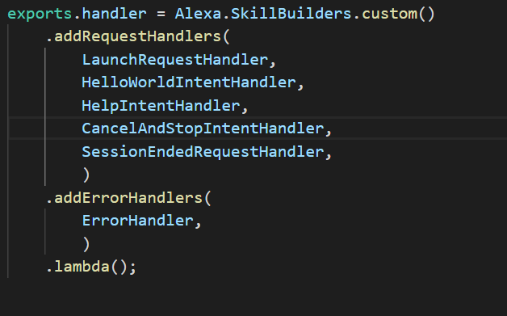
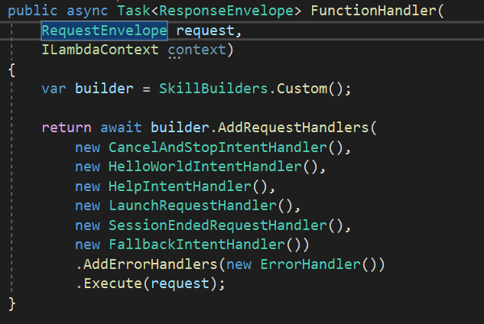
NodeJS vs. .Net Core

Slide 12
CustomSkillBuilder
Class which helps in building a customized skill.
Configures custom Skill
Registers Request handlers
Registers Request and Response interceptors
Processes incoming request
Generates outgoing response
Optionally configures custom persistence layer (DynamoDB and CosmosDB)

Slide 13
IRequestHandler
Interface used to handle incoming requests
Determines if handler can respond to incoming request
If handler can handle incoming request, processes request and creates response.
Two methods:
CanHandle
Handle

Slide 14
IRequestInterceptor
Interface used to intercept incoming requests and process
Used to intercept incoming requests and perform actions prior to processing
One method defined:
Process
Most common use case is localization

Slide 15
IResponseInterceptor
Interface used to intercept outgoing responses prior to returning to user
Used to intercept outgoing requests and perform actions prior to returning response to users
One method defined:
Process
Possible use cases include:
Adding or removing custom headers
Response transformation

Slide 16
Questions?

Slide 17

Nicholas Cipollina
Technical director
Nick Cipollina is a Technical director at CapTech. He is an experienced .Net Architect with a passion for developing enterprise-level software. With over 14 years of software development experience, Nick has designed and developed web, mobile, and content management solutions on many different platforms. He is a leader at CapTech, heading up the Cloud Service Offering and the NLP & Bots interest group. In his free time, Nick likes to watch movies and spend time with his family. A fun fact about Nick is that his last name means "little onion" in Italian.

Slide 18
Appendix
ASK SDK for .Net Core
ASK SDK for NodeJS
Amazon Developer Portal
Alexa Skills SDK for .Net

